Slide 1



PRESENTATION
OF CHANGING AN ER DIAGRAM INTO RELATION MODEL

Slide 2
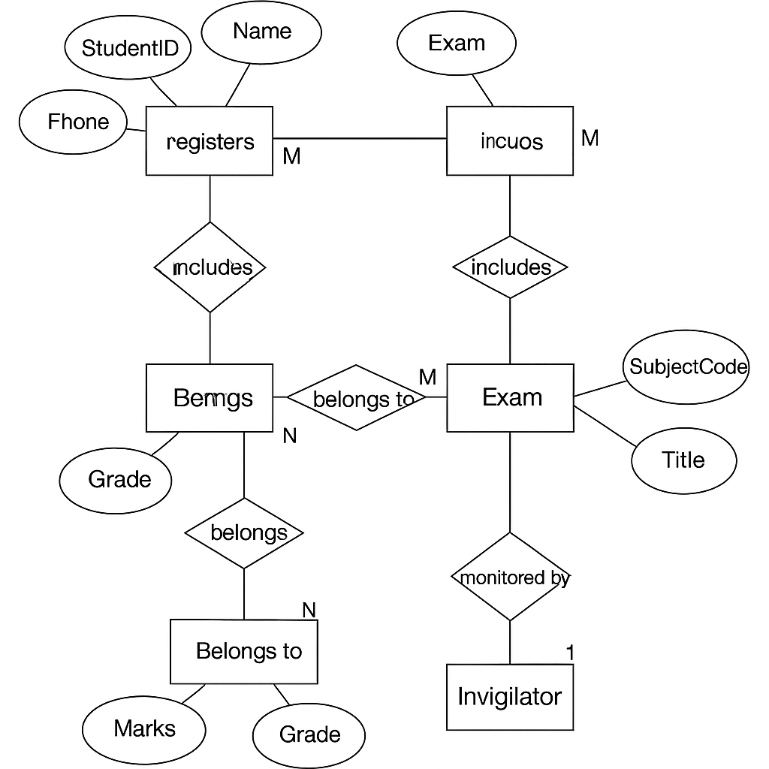

-ID
EXAM
Er diagram of Student Exam Management System
RESULT
MARKS

Slide 3
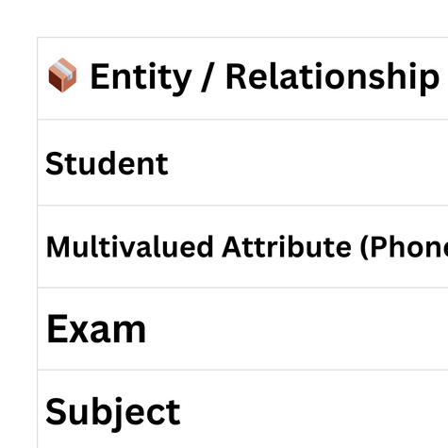
Conversion of Er diagram into relational model

Slide 4
THANK YOU

